Slide 1
Working with NYCHA SQL Databases
An Introduction

Slide 2
Outline
Overview and Rationale
Prep Work
Gaining Access
Software Setup
Searching for Data
Anatomy of a Query
Query Examples
Place in Analytical Workflow

Slide 3
Why bother?
NYCHA stores the vast majority of its operational and administrative data in structured, table-based databases
MAXDB: Holds all data entered and accessed through the Maximo platform, including work order information and labor transactions
EDWPRD: Underpins the Data Warehouse, OBIEE dashboards, and other tools. Holds archived copies of Maximo data as well as most other data, including procurement information, time and pay records, and sensitive staff information (handle with care)
Accessing database directly allows exact control over the size and scope of data extracts, and removes the need to seek a specific “data download” portal

Slide 4
Prep Work: Gaining Access
Access to MAXDB and/or EDWPRD, contact IT Enterprise Solutions Management Department
Current VP: Sandip Shah (Sandip.Shah6@nycha.nyc.gov)
Helpful in past: Shashi Jha (Shashi.Jha@nycha.nyc.gov)
Oracle DB Distribution List (DL_Oracle_DBA@nycha.nyc.gov)
On EDWPRD, specify schemas to access:
EISDW
NICEDW (if necessary — contains sensitive info)
EBSDW (for procurement data)

Slide 5
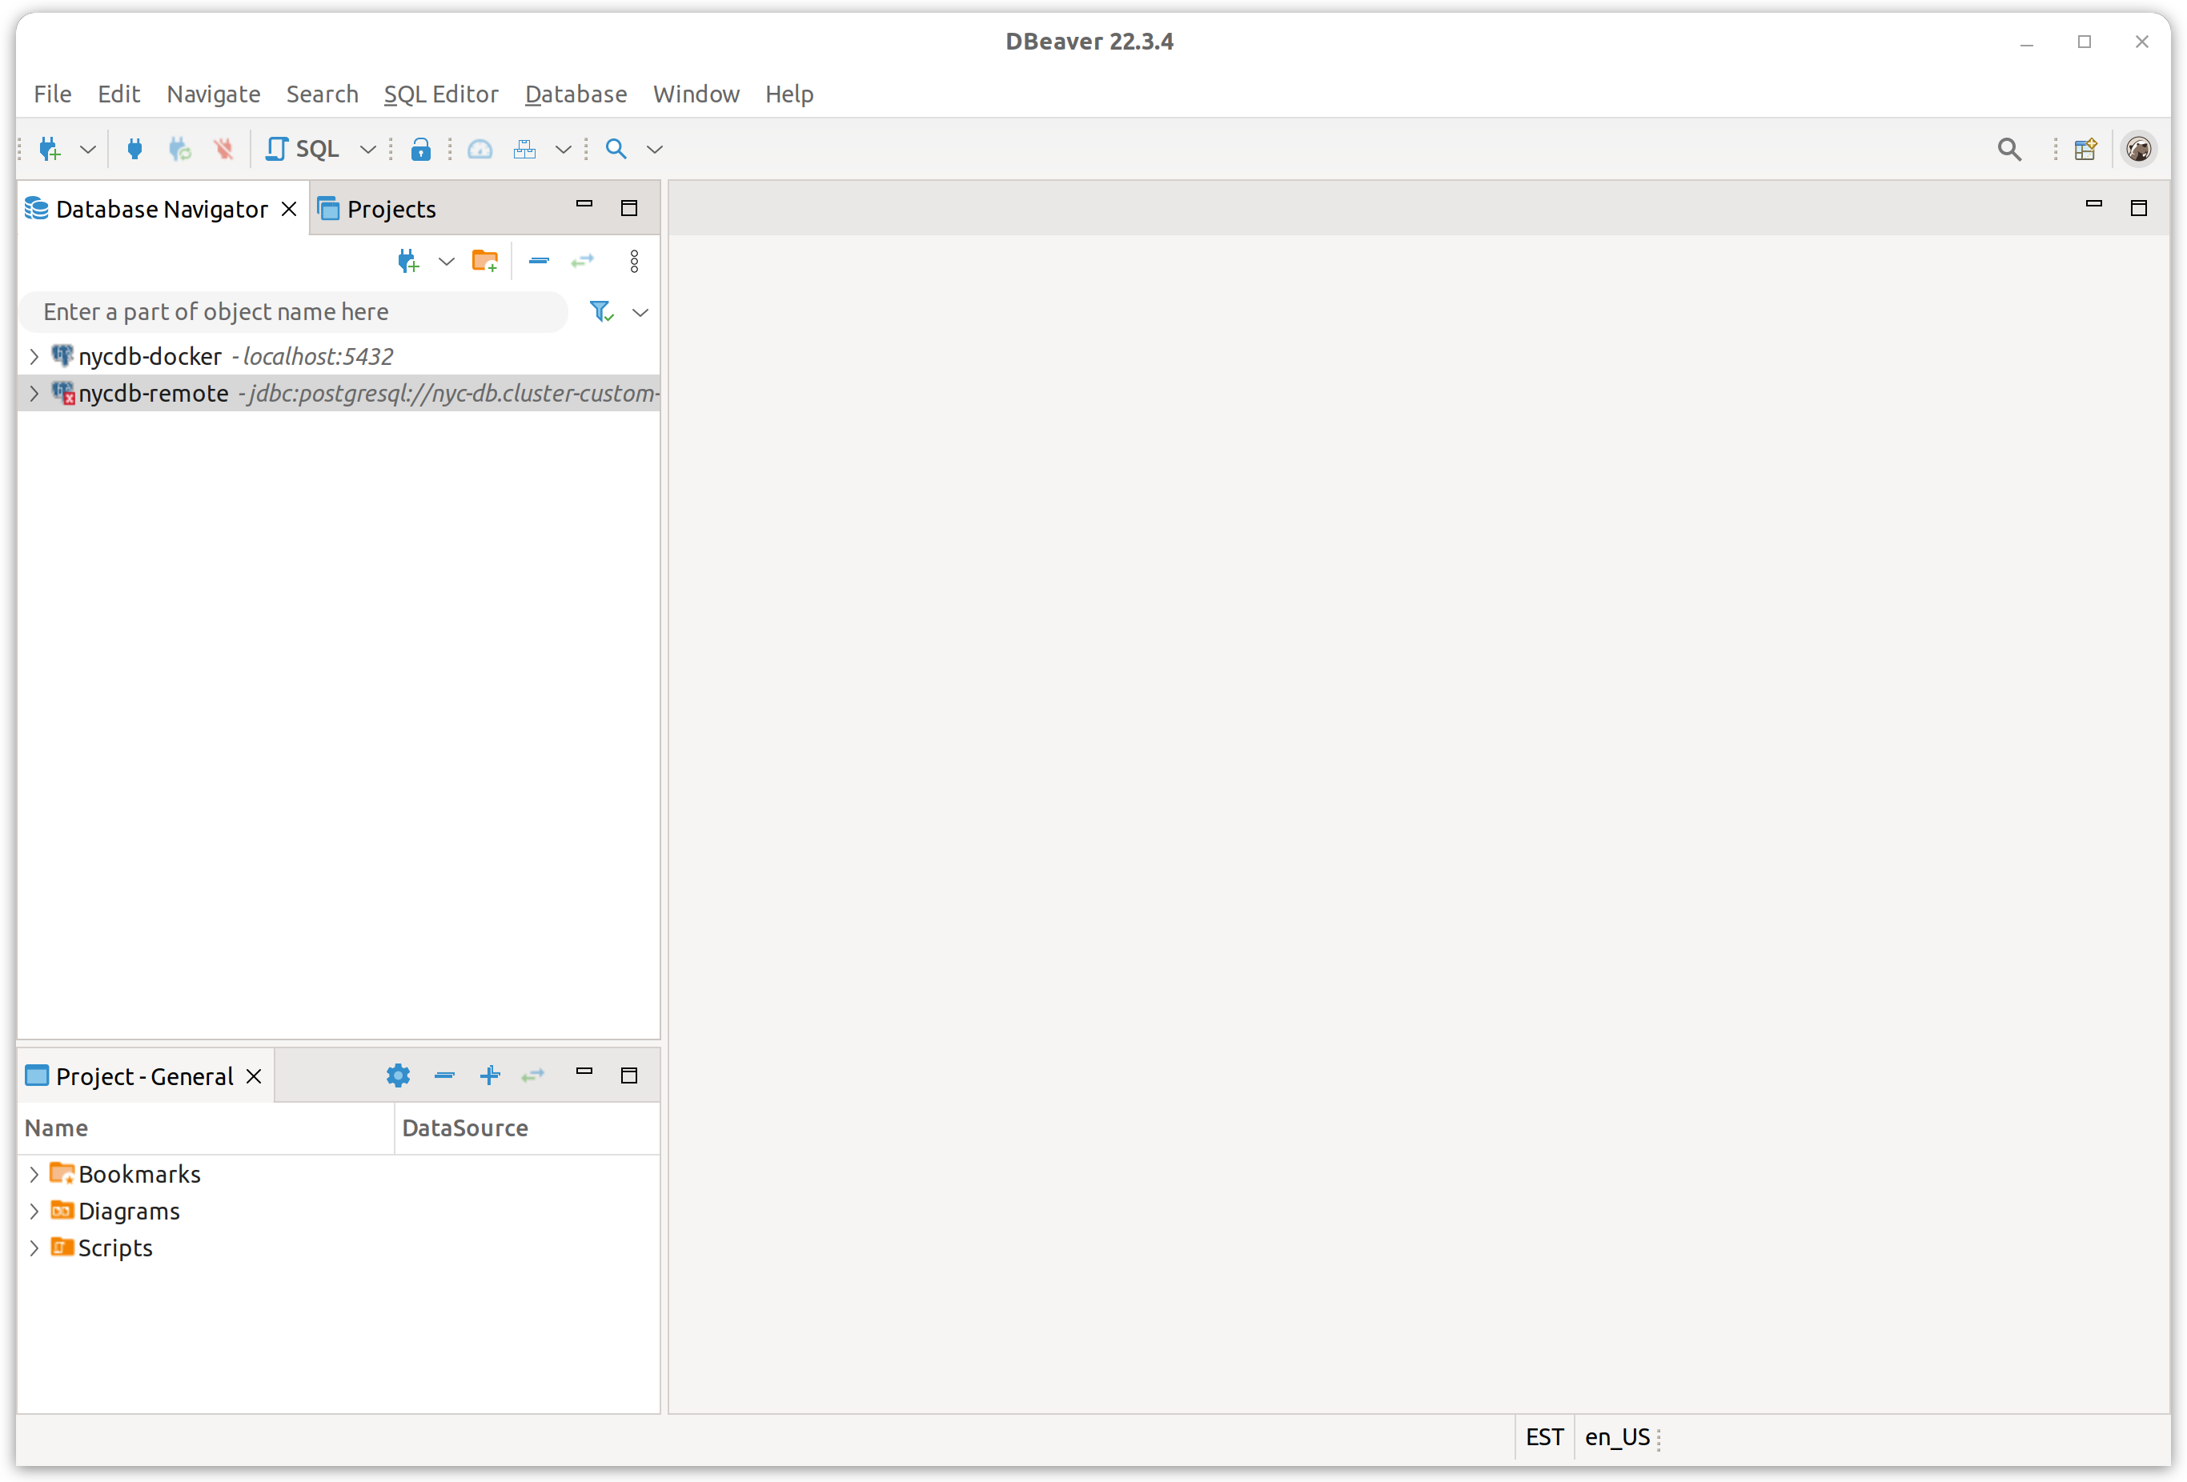
Prep Work: Setting up client
Download your preferred SQL client, which you’ll use to access and query databases
Recommended: DBeaver; no admin access needed if using .zip file
Lighter alternative: Oracle SQL Developer; requires Oracle account
Unzip and open client

Slide 6
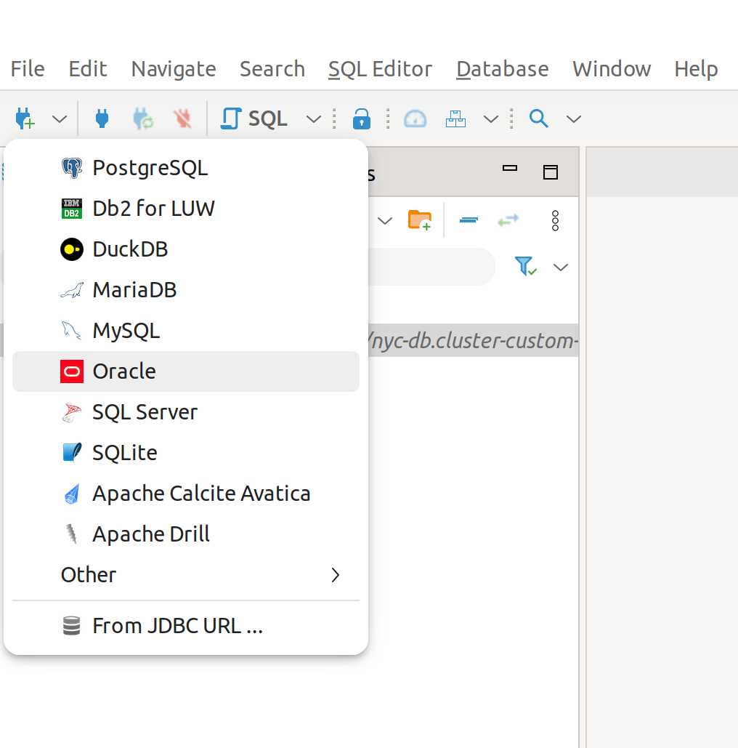
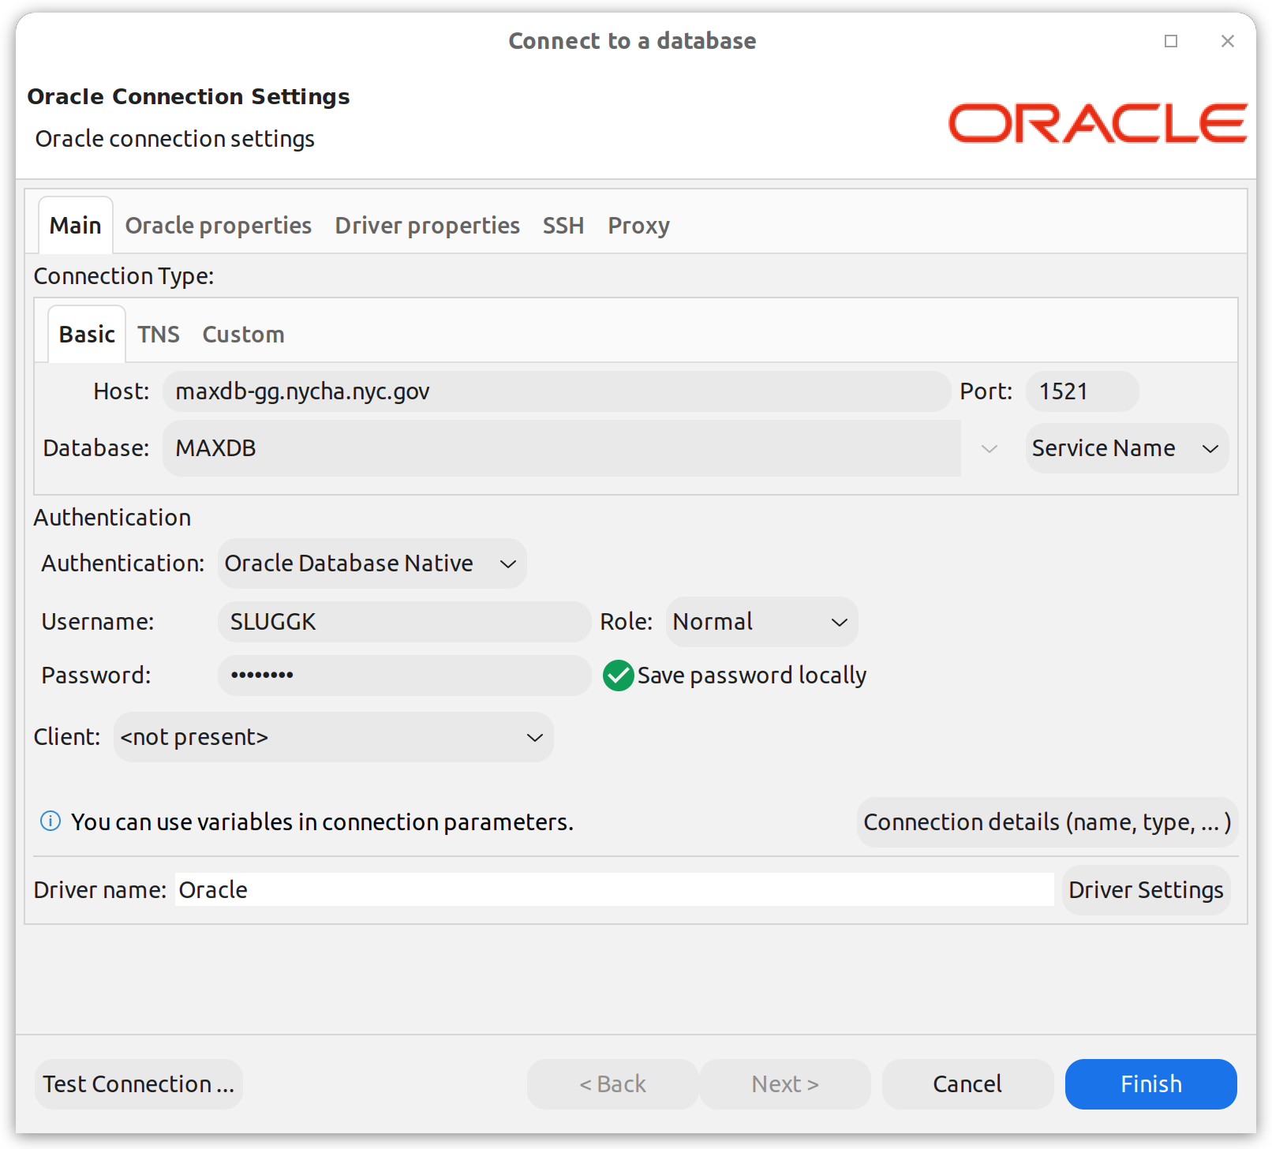
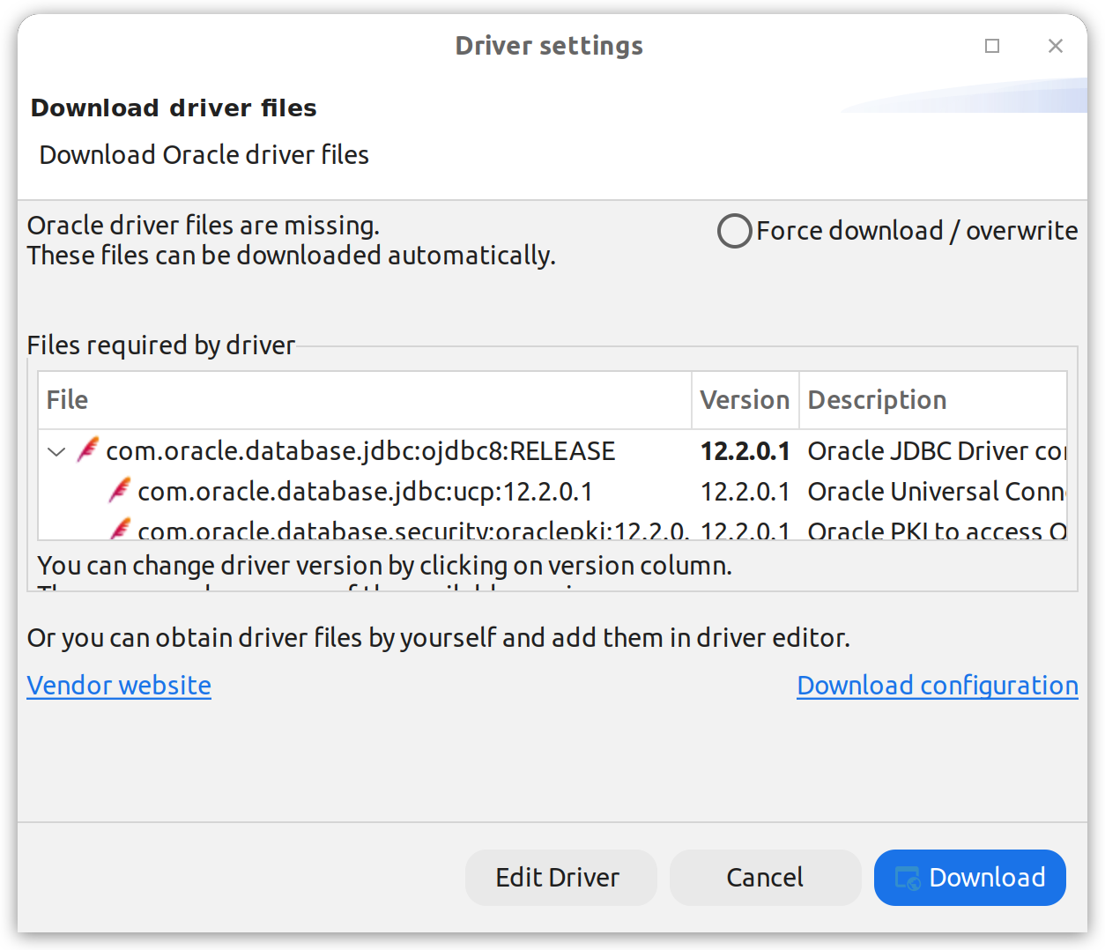
Prep Work: Setting up client
Add a new SQL connection
Panel on right shows MAXDB info. Additional information can be found in Appendix I.
If prompted, download Oracle SQL drivers

Slide 7
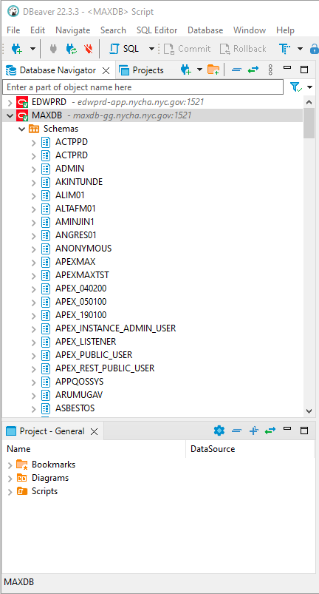
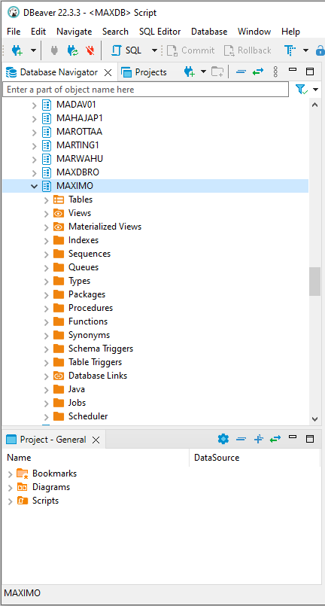
Searching for Data
Within database, first find schema of interest. Schemata often group tables with similar “topics” or those requiring similar levels of permission to access
In MAXDB, the MAXIMO schema is of primary interest
In EDWPRD:
EISDW holds most frequently used data
NICEDW holds more sensitive data, incl. link between employee names and IDs
EBSDW holds misc. other data, including procurement-related info

Slide 8
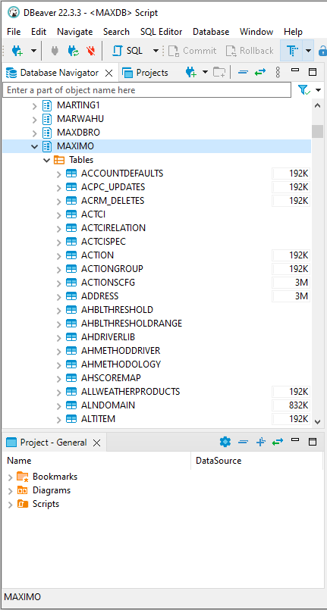
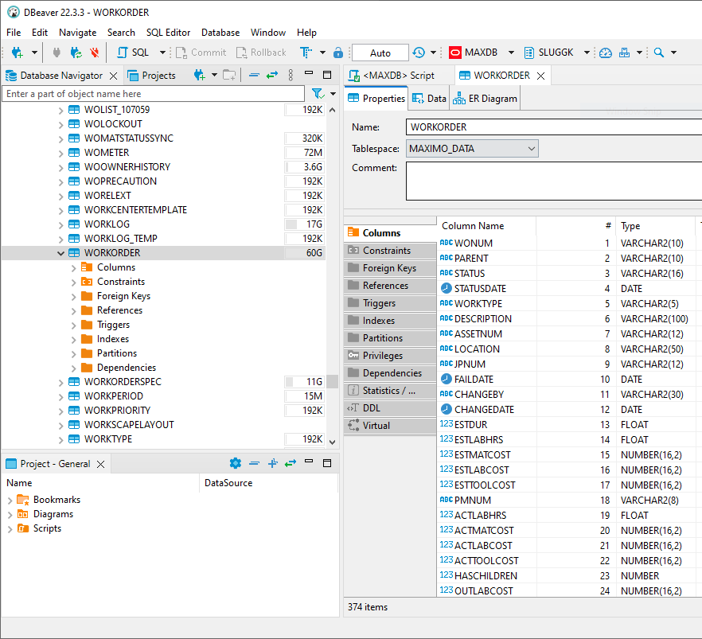
Searching for Data
Tables hold the actual data we want — look for suggestive table names (like ‘WORKORDER’) while exploring. See Appendix II for examples.
Individual records are rows, while various attributes (“fields”) are held in columns. In DBeaver, double-click a table’s name to view its properties, including column names.
In general, take note when separate tables contain identical fields, which can be used to link records of various types.

Slide 9
Anatomy of a Query
SELECT WONUM, STATUS, LOCATION
FROM MAXIMO.WORKORDER
WHERE WORKTYPE = ‘CM’
What columns or values do you want?
What table(s) are you pulling from?
What conditions need to be met?

Slide 10
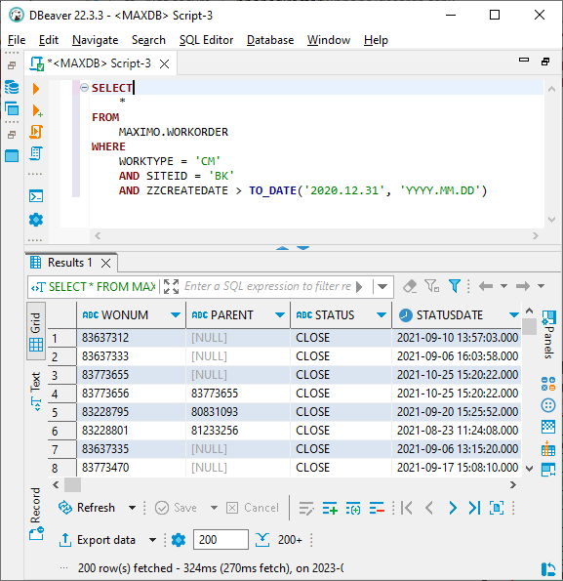
Example 1: Work Orders
Pull all fields/columns
From the table MAXIMO.WORKORDER
That are:
Of the corrective maintenance class
From Brooklyn
Created in 2021 or later (i.e., after Dec. 31, 2020)

Slide 11
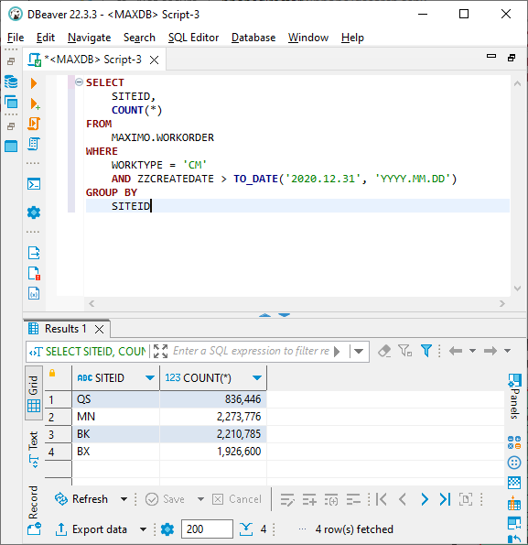
Example 2: Work Orders by Borough
Pull:
SITEID (i.e., Borough)
Row count
From the table MAXIMO.WORKORDER
That are:
Of the corrective maintenance class
Created in 2021 or later (i.e., after Dec. 31, 2020)
Grouped by SITEID (when performing group operations like counting)

Slide 12
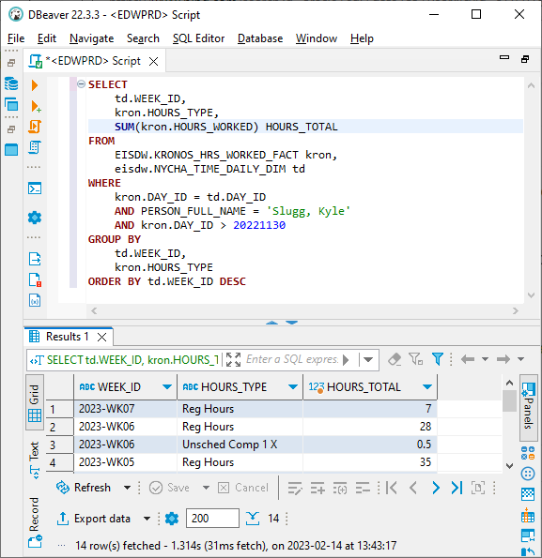
Example 3: Hours by Week
Pull:
WEEK_ID from “td”
HOURS_TYPE from “kron”
Sum of HOURS_WORKED from “kron,” alias HOURS_TOTAL
From:
EISDW.KRONOS_HRS_WORKED_FACT, alias “kron”: daily hours worked by person and type
EISDW.NYCHA_TIME_DAILY_DIM, alias “td”: maps unique days (DAY_ID) to units of time
That are:
Linked between tables by the column DAY_ID
Associated with the name ‘Slugg, Kyle’
From Dec. 2022 or later (i.e., after Nov. 30, 2022)
Grouped by:
WEEK_ID
HOURS_TYPE
Sorted by WEEK_ID, in descending order

Slide 13
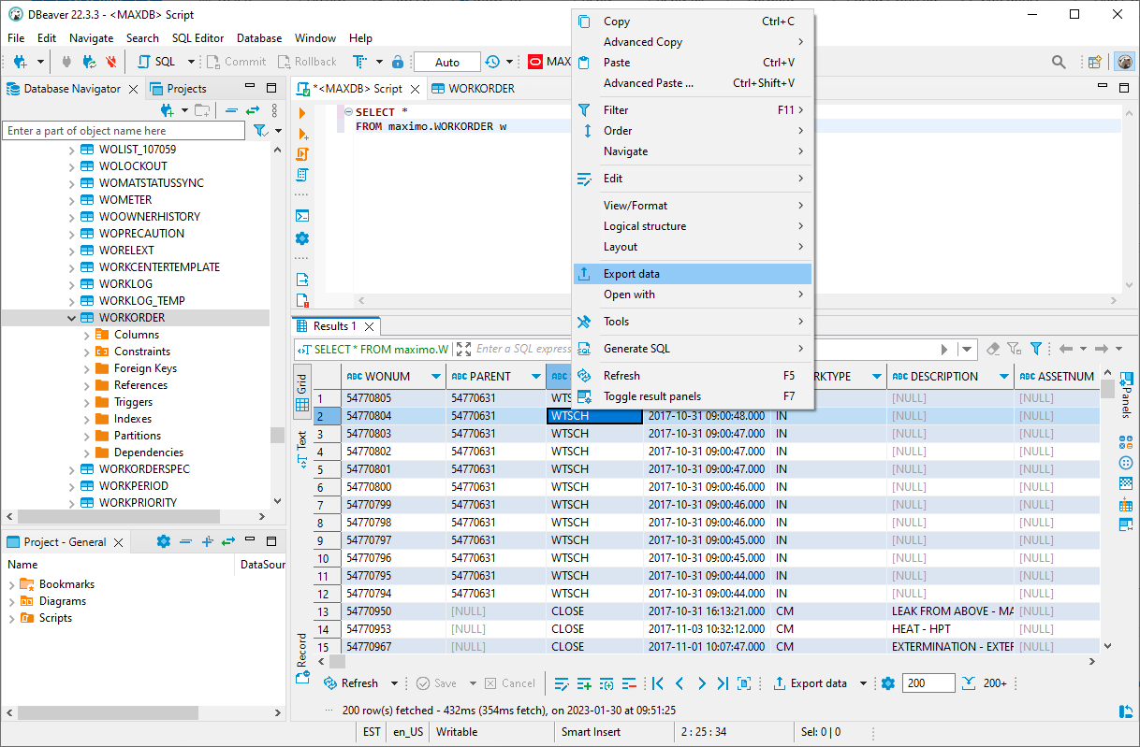
Next Steps: Exporting Data
Reshaping data directly in SQL with grouping and sorting is slow and can get complicated quickly, limiting our ability to produce useful analysis natively
We often export pulled data for analysis elsewhere, using tools like Excel or Python libraries
In DBeaver: right-click on the “Results” pane and select “Export data”
Formats include .csv (most useful for our purposes)
Certain tools can also connect to these databases directly. See the attached Jupyter Notebook overview for details.

Slide 14





Next Steps: Options for Additional Analysis
Microsoft Excel
Display tables, Pivot Tables
Simple charts
Graphical interface for data manipulation
Jupyter Notebook
Automates analysis for reuse with additional or updated datasets
Extremely flexible table, Pivot Table formatting
Highly customizable charts
Interactive interface combined with Python code
GIS tools (QGIS, Esri ArcGIS)
Mapping and spatial visualization
Spatial statistical analysis
Custom functionality via Python scripting

Slide 15
Appendices

Slide 16
Appendix I: Credentials and Connection Params
The following credentials can be used to access MAXDB and EDWPRD until you are able to obtain your own. PLEASE DO NOT SHARE OR MAKE IT KNOWN THAT THESE HAVE BEEN SHARED.
MAXDB
Parameters (public)
Host: maxdb-gg.nycha.nyc.gov
Port: 1521
Database: MAXDB
Credentials (sensitive)
Username: SLUGGK
Password: WELCOME1
EDWPRD
Parameters (public)
Host: edwprd-app.nycha.nyc.gov
Port: 1521
Database: EDWPRD
Credentials (sensitive)
Username: nice_eis_ro
Password: nero

Slide 17
Appendix II: Directory of Useful Tables
With all credit to Hannah Gorman: information on useful tables (and related info) can be found here.
In addition to those in Hannah’s document, queries related to various datasets (work orders, hours, assets, etc.) can be found in the “_Query_Library” directory of this repository.

